Slide 1
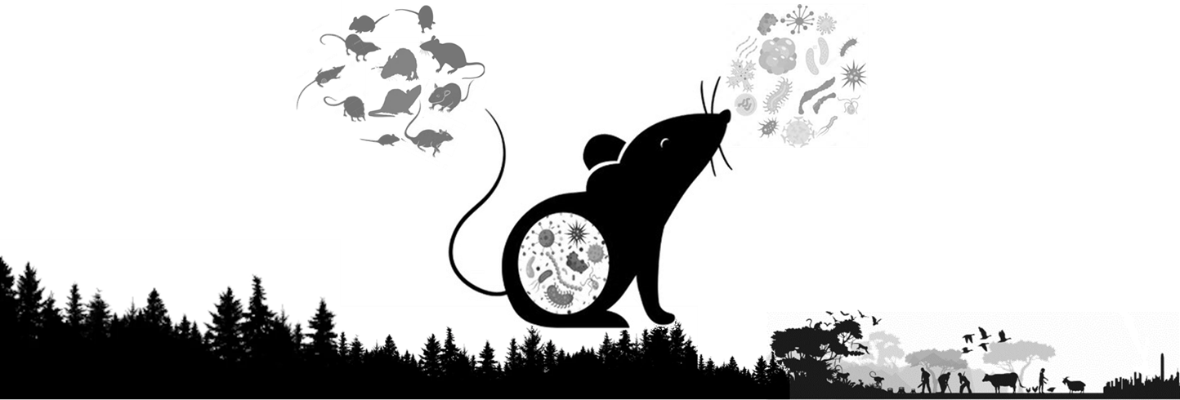
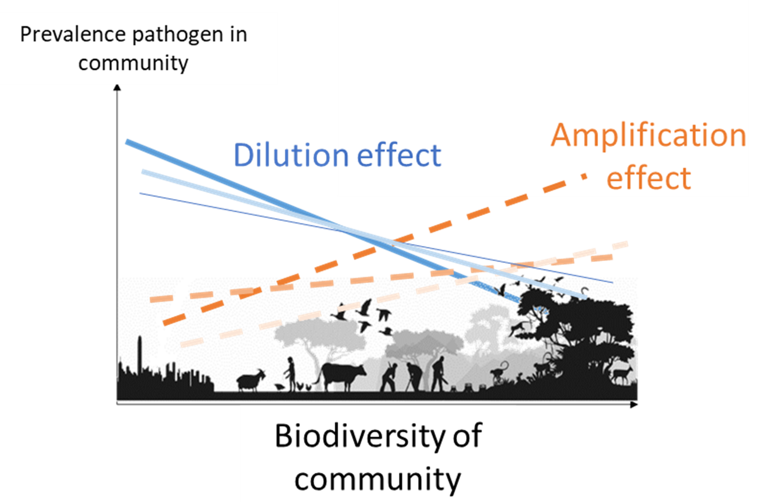
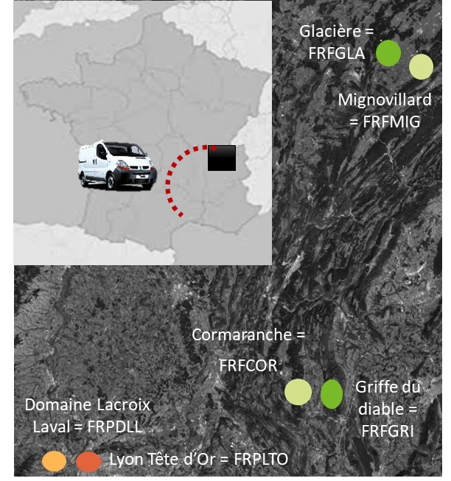
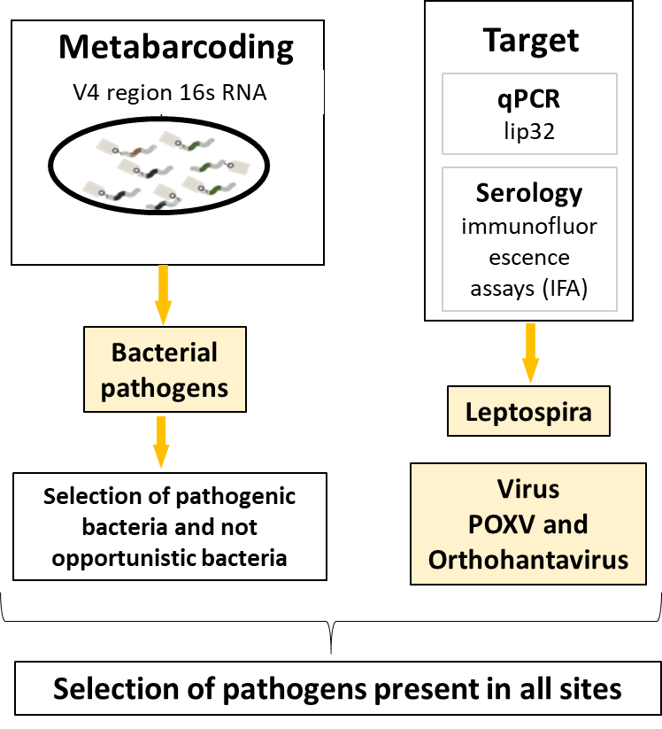
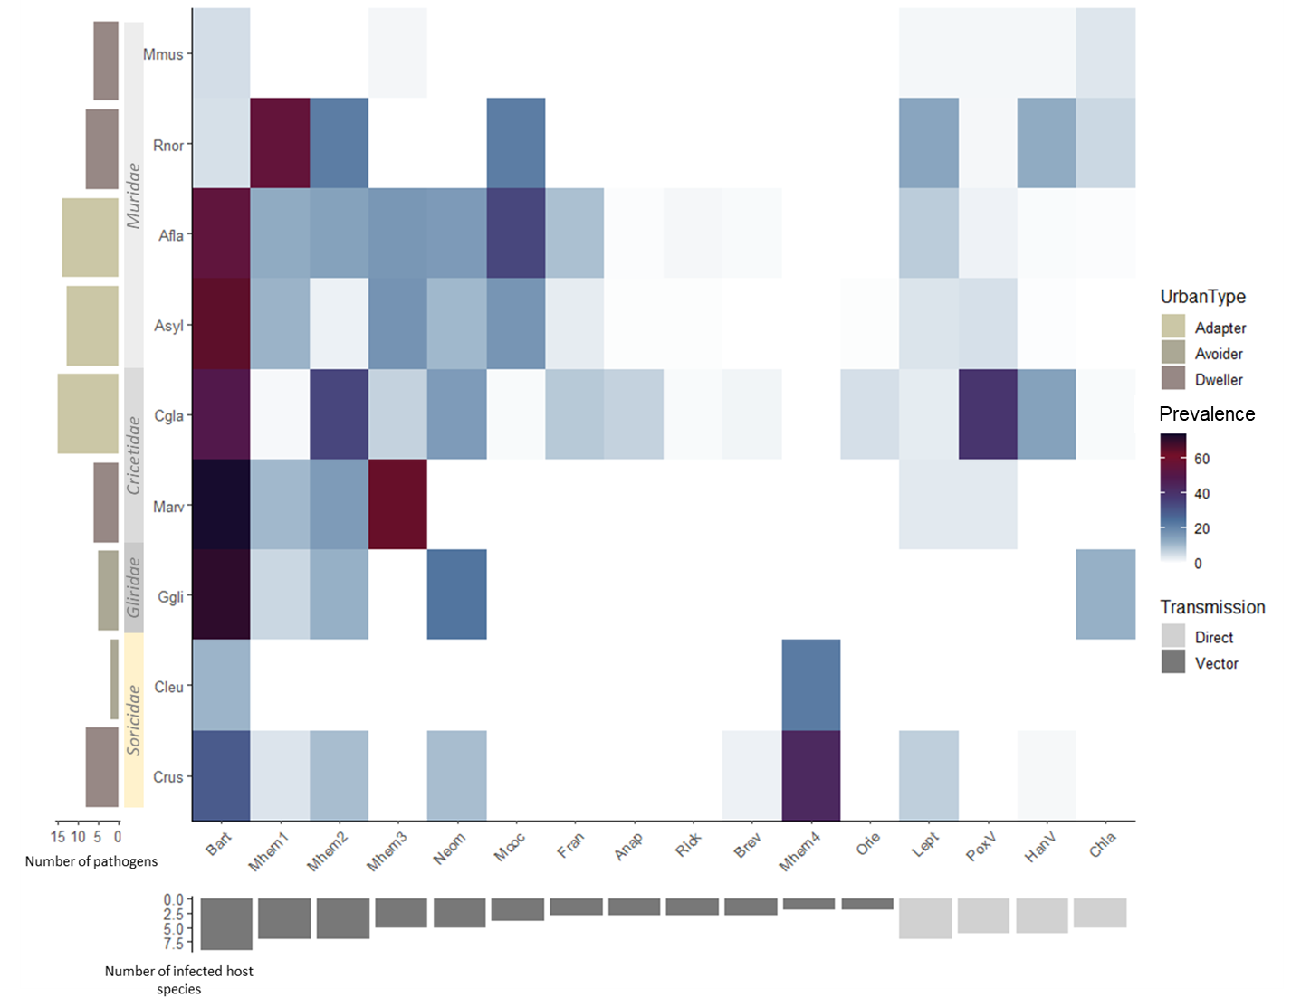
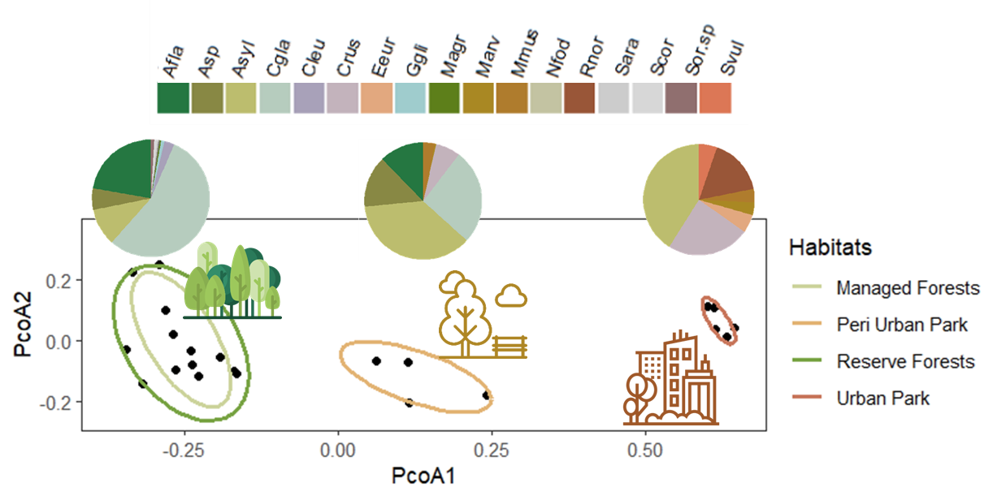
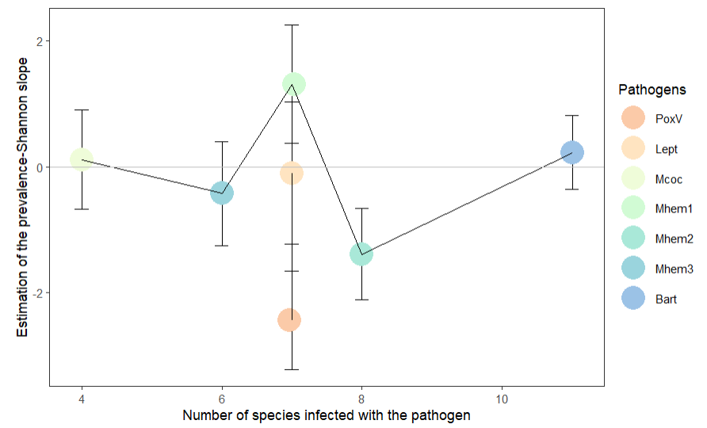
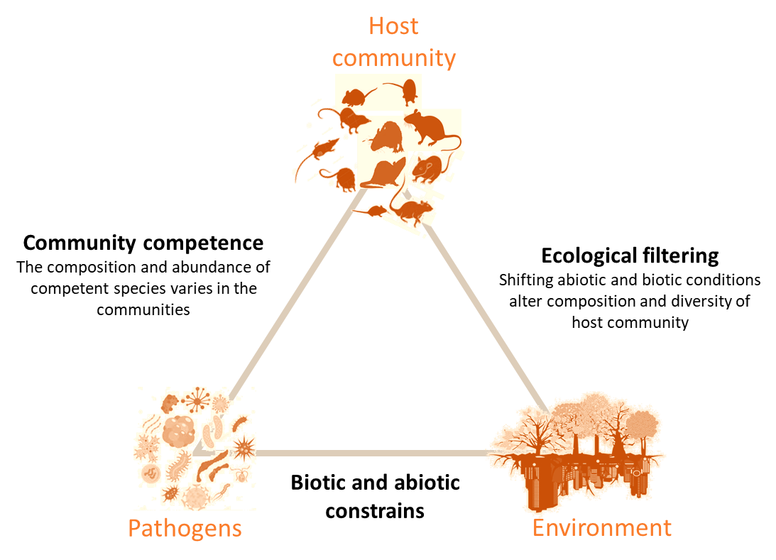
Exploring the relationships between the biodiversity of small mammal communities and multi-pathogens prevalence
Bouilloud M., Galan M., Bordes A., Tatard C., Pradel J., Loiseau A., Alburkat H., Dutra L., Sironen T., Roche B., Charbonnel N.
Background
Questions
Emerging zoonotic diseases pose a significant threat to global health. Their emergence is driven by human-induced changes in biodiversity.
1. Does the biodiversity of small mammals correlate with the prevalence of pathogens?
Does the correlation indicate a dilution or amplification effect for a given pathogen?
2. What drives the relationships between biodiversity and pathogens’ prevalence ?
Variability in host “competence” with regard to the pathogens studied ?
Relationship between host biodiversity and the abundance of the most competent hosts ?
This relationship can result in a dilution or an amplification effect of pathogens’ prevalence.
Understanding the complex interplay between biodiversity and zoonotic risk is crucial for effective disease prevention
and management.
Pathogens’ prevalence
Objectives
We aim to determine the relationships between the biodiversity of small mammal communities and the prevalence of different (zoonotic) pathogens.
We aim to investigate the ecological mechanisms driving these relationships.
Host biodiversity
Small mammals
are sampled
in forests and
urban parks
in France
Pathogens prevalence
Sampling plan
Data
acquisition
glmer(presence/absence pathogens ~ Host species *Pathogens species + Sex + Sexual maturity + Region + Period+(1|Id), data, family=binomial)
There are differences in the prevalence of pathogens between host species.
Pathogens vary in their mode of transmission and host specificity.
Multiple host species diverge phylogenetically, in their ecological niche and reservoir competence.
Small mammals species
Trapping success
For most pathogens, there are differences in host competence (or preference)
Pathogens
Small mammal communities
-
Links between host biodiversity and pathogens’ prevalence
Multivariate analysis of small mammal relative abundance
Biodiversity
and abundance of the most competent hosts
The relationship between host biodiversity and pathogen prevalence depends on the pathogens species
Host
Species
Prevalence of pathogens
Amplification
= correlation +
glmer(presence/absence pathogens ~ Diversity*Pathogens species +Sex+Sexual maturity+Region+Period+(1|Id), data, family=binomial)
Pathogens
Dilution
= correlation -
Dilution effect for POXV and Mycoplasma hemomuris2
Amplification effect for Mycoplasma hemomuris1
No significant effect for other pathogens
-
-
-
Biodiversity
-
+
Amplification
Biodiversity
There are differences in the diversity and composition of host communities along the anthropization gradient
Variation in Pearson correlation
between the abundance (Shannon index) of the most competent host and the prevalence of seven pathogens (Bartonella sp, Mycoplasma sp, cowpox virus and Leptospira).
Direct transmission
Anthropization
Take home message
Anthropization has an impact on the diversity and composition of small mammal communities. It may affect the abundance of host species that are more or less competent for a particular pathogen.
For POXV, Mycoplasma hemomuris2 and Bartonella :
when the biodiversity is low, there is a high abundance of the most competent hosts
Vector transmission
The relationships between pathogens prevalence and small mammal biodiversity vary depending on the pathogen species studied. Both dilution and amplification effects were observed in response to forest anthropization.
Dilution
There are variations in host competence with regard to the pathogens detected.
Acknowledgement of the funders of the BioRodDis project
Contacts
Dilution effect is observed for POXV and Mycoplasma hemomuris2 in response to anthropization.
It may be driven by the increase in the relative abundance of their "most competent" host (bank vole) when biodiversity decreases.
Laboratories and doctoral school involved
@BouilloudM
marie.bouilloud@gmail.com

